Slide 1

Pass It On – State Management with Pinia
MANUEL FERNANDO GALLEGO ARIAS

Slide 2

Agenda
About myself
Recap: state management
What, Why and how pinia works
Live code – trello app
Motivation to join our community
Q&A
Notes:
Agenda Slide (version B)
This slide should provide the audience with the “chapters” of the “story.”
Change the header and footer in the master slides to reflect the client name and presentation name.
These chapter titles should match the Chapter Intro Slides throughout the deck (see slide 4).
There are two versions of this slide: black and white (see previous slide).

Slide 3

1
1
About Myself
Manuel Fernando Gallego Arias
REI - CLS Project
Notes:
Agenda Slide (version B)
This slide should provide the audience with the “chapters” of the “story.”
Change the header and footer in the master slides to reflect the client name and presentation name.
These chapter titles should match the Chapter Intro Slides throughout the deck (see slide 4).
There are two versions of this slide: black and white (see previous slide).

Slide 4

2
Recap about state management
What is state management.
When use state management.
Notes:
Chapter Intro Slide (version K)
This slide should be used at the beginning of each “chapter” of your presentation (as introduced in the Agenda slide) to keep the audience aware of their place in the story and to help break things up. Change the text and chapter number accordingly. If you do not need a sub-head (the smaller text), delete it. Use different backgrounds for different chapter titles, try not to repeat a background.
Very short presentations (< ~10 slides) may not need Chapter Intro Slides.
There are multiple versions of this template with various white and black background images starting on slide 10.

Slide 5
3
What, Why and How Pinia works
Notes:
Chapter Intro Slide (version N)
This slide should be used at the beginning of each “chapter” of your presentation (as introduced in the Agenda slide) to keep the audience aware of their place in the story and to help break things up. Change the text and chapter number accordingly. If you do not need a sub-head (the smaller text), delete it. Use different backgrounds for different chapter titles, try not to repeat a background.
Very short presentations (< ~10 slides) may not need Chapter Intro Slides.
There are multiple versions of this template with various white and black background images starting on slide 10.

Slide 6



Past It On - 2. What, Why and How Pinia works
WHAT IS PINIA
Pinia redesigned the definition about what a State is for Vue. It could look like the Composition API work, designed in November 2019.
Pinia works for both Vue 2 and Vue 3 and doesn't require you to use the composition API.
Pinia is now the de-facto standard to work with Vue.
WHY WE SHOULD USE PINIA
To manage the state of large applications in a safe and controled way.
Pinia is modular by design.
Devtools make development easy.
Pinia has built- in Typescript support.
Vuex has been deprecated like recommendation.
HOW PINIA WORKs
Pinia is more easy than Vuex.
npm install pinia
Add Pinia lib to the app:
const app = createApp(App); app.use(createPinia()); app.mount("#app");
Add Pinia lib to the app:
actions: { increment(value = 1) { this.count += value; }, },
Notes:
Elements (version 2)
Elements are used to give more detail to a set of ideas, they should all relate to the same topic.
Use this page for a list of deliverables, key roles on a project, phases of a project, or any topic that can be broken down into more specific examples.
Each section should have an icon that relates to the content of that specific element, no icon should be repeated on the same page, and they should all be the same colour.
Keep the text to 1-2 sentences and aim to have about the same amount of content under each element.

Slide 7
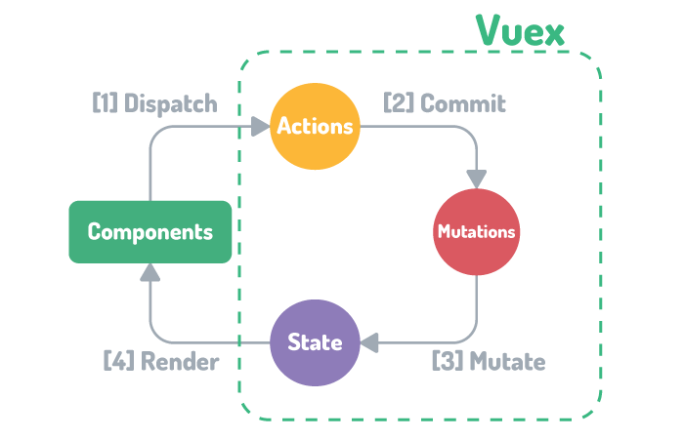
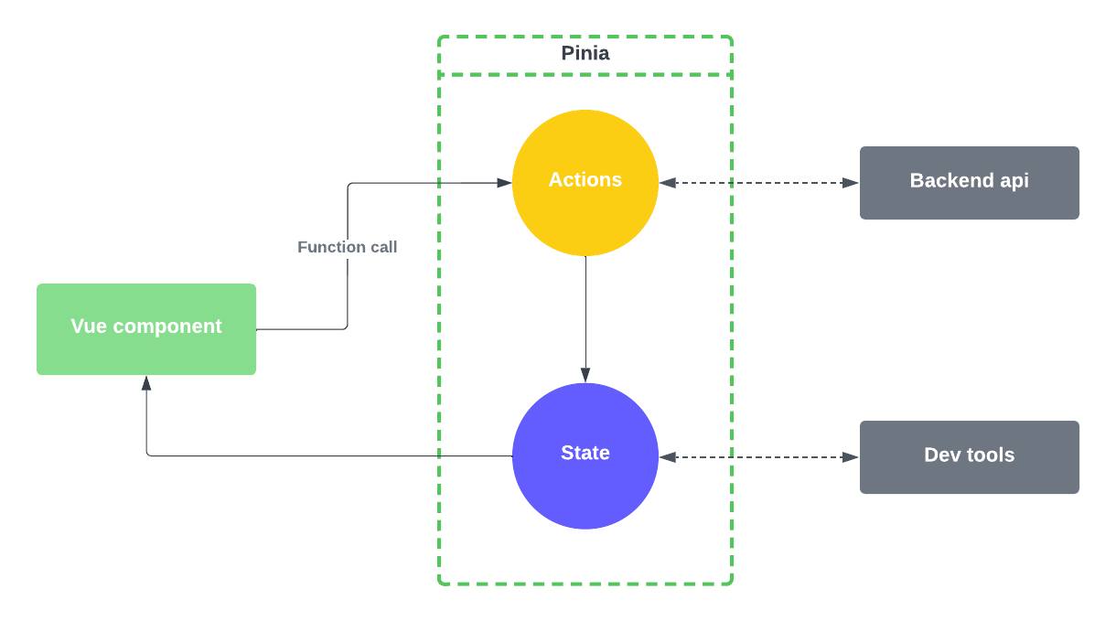
Vuex Diagram
Pinia Diagram
Notes:
Data slide (version 7)
If the data is best represented in a bar chart, use this slide.
Double click the chart and a button will appear that says “Edit Chart Data” to customize the chart.
If more than 3 pieces of data need to be represented, refer to page 8 on how to use the Endava brand palette to include secondary colours.

Slide 8
4
LIVE CODE – TRELLO APP
Go to my repository:
https://github.com/mgallegoa?tab=repositories
https://www.vuemastery.com/courses/watch-us-build-trello-clone/opening-tasks-in-a-modal/
Notes:
Chapter Intro Slide (version N)
This slide should be used at the beginning of each “chapter” of your presentation (as introduced in the Agenda slide) to keep the audience aware of their place in the story and to help break things up. Change the text and chapter number accordingly. If you do not need a sub-head (the smaller text), delete it. Use different backgrounds for different chapter titles, try not to repeat a background.
Very short presentations (< ~10 slides) may not need Chapter Intro Slides.
There are multiple versions of this template with various white and black background images starting on slide 10.

Slide 9
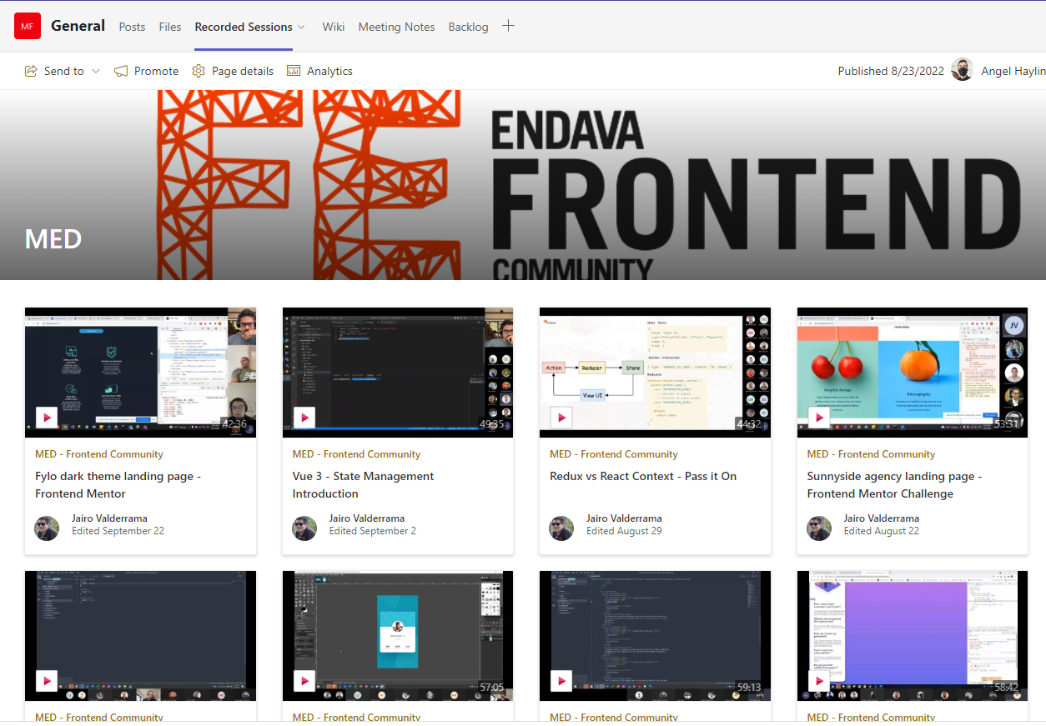
5
Notes:
Chapter Intro Slide (version N)
This slide should be used at the beginning of each “chapter” of your presentation (as introduced in the Agenda slide) to keep the audience aware of their place in the story and to help break things up. Change the text and chapter number accordingly. If you do not need a sub-head (the smaller text), delete it. Use different backgrounds for different chapter titles, try not to repeat a background.
Very short presentations (< ~10 slides) may not need Chapter Intro Slides.
There are multiple versions of this template with various white and black background images starting on slide 10.

Slide 10
Thanks and Q&A

